Slide 1

To Boldly Preserve: Collecting and Preserving the Next Stage of Space Exploration and Exploitation
Jonathan Coopersmith
Texas A&M University
Angelina Callahan
Naval Research Lab
Geoffrey Nunn
The Museum of Flight
Erik Rau
Hagley Museum & Library
Copyright © by Jonathan Coopersmith.
Published by the American Institute of Aeronautics and Astronautics, Inc., with permission.
www.ascend.events

Slide 2

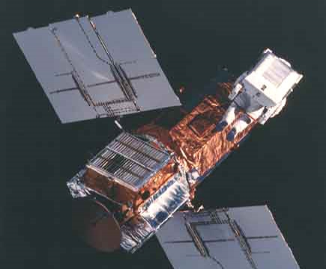
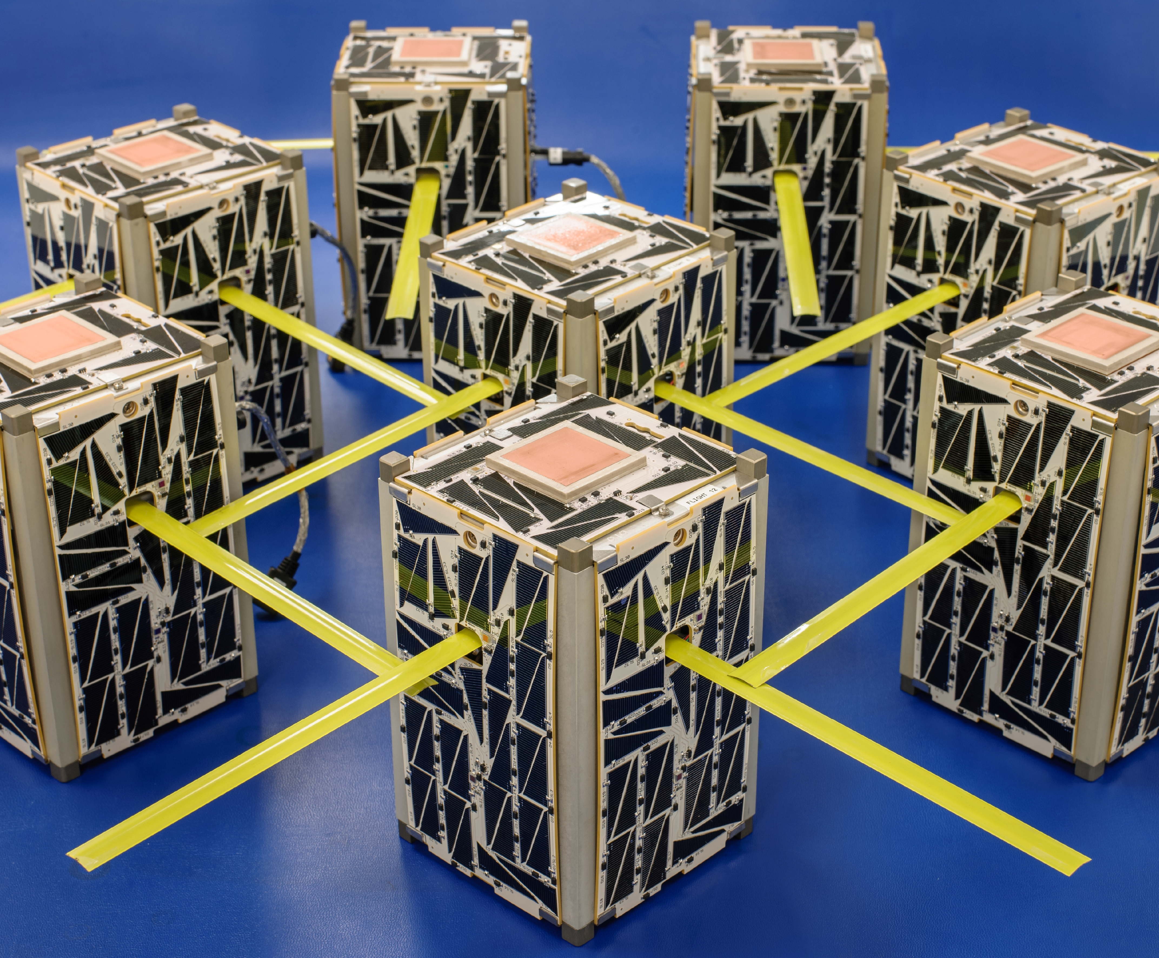
To Boldly Preserve
A Good Problem: How to collect and preserve 21st century space?
20th century space
  Monolithic
  Primarily Government
  Bound by Recordkeeping Requirements
    NARA, NASM, NASA History, Etc.
21st century space
  Increasingly Diverse
  Entrepreneurial/Commercial
  No requirement to capture its history
Images - NASA

Slide 3

To Boldly Preserve
toboldlypreserve.space
Why should we preserve and collect our history?
What should we preserve?
How do we preserve our history?
What are common concerns to consider?

Slide 4
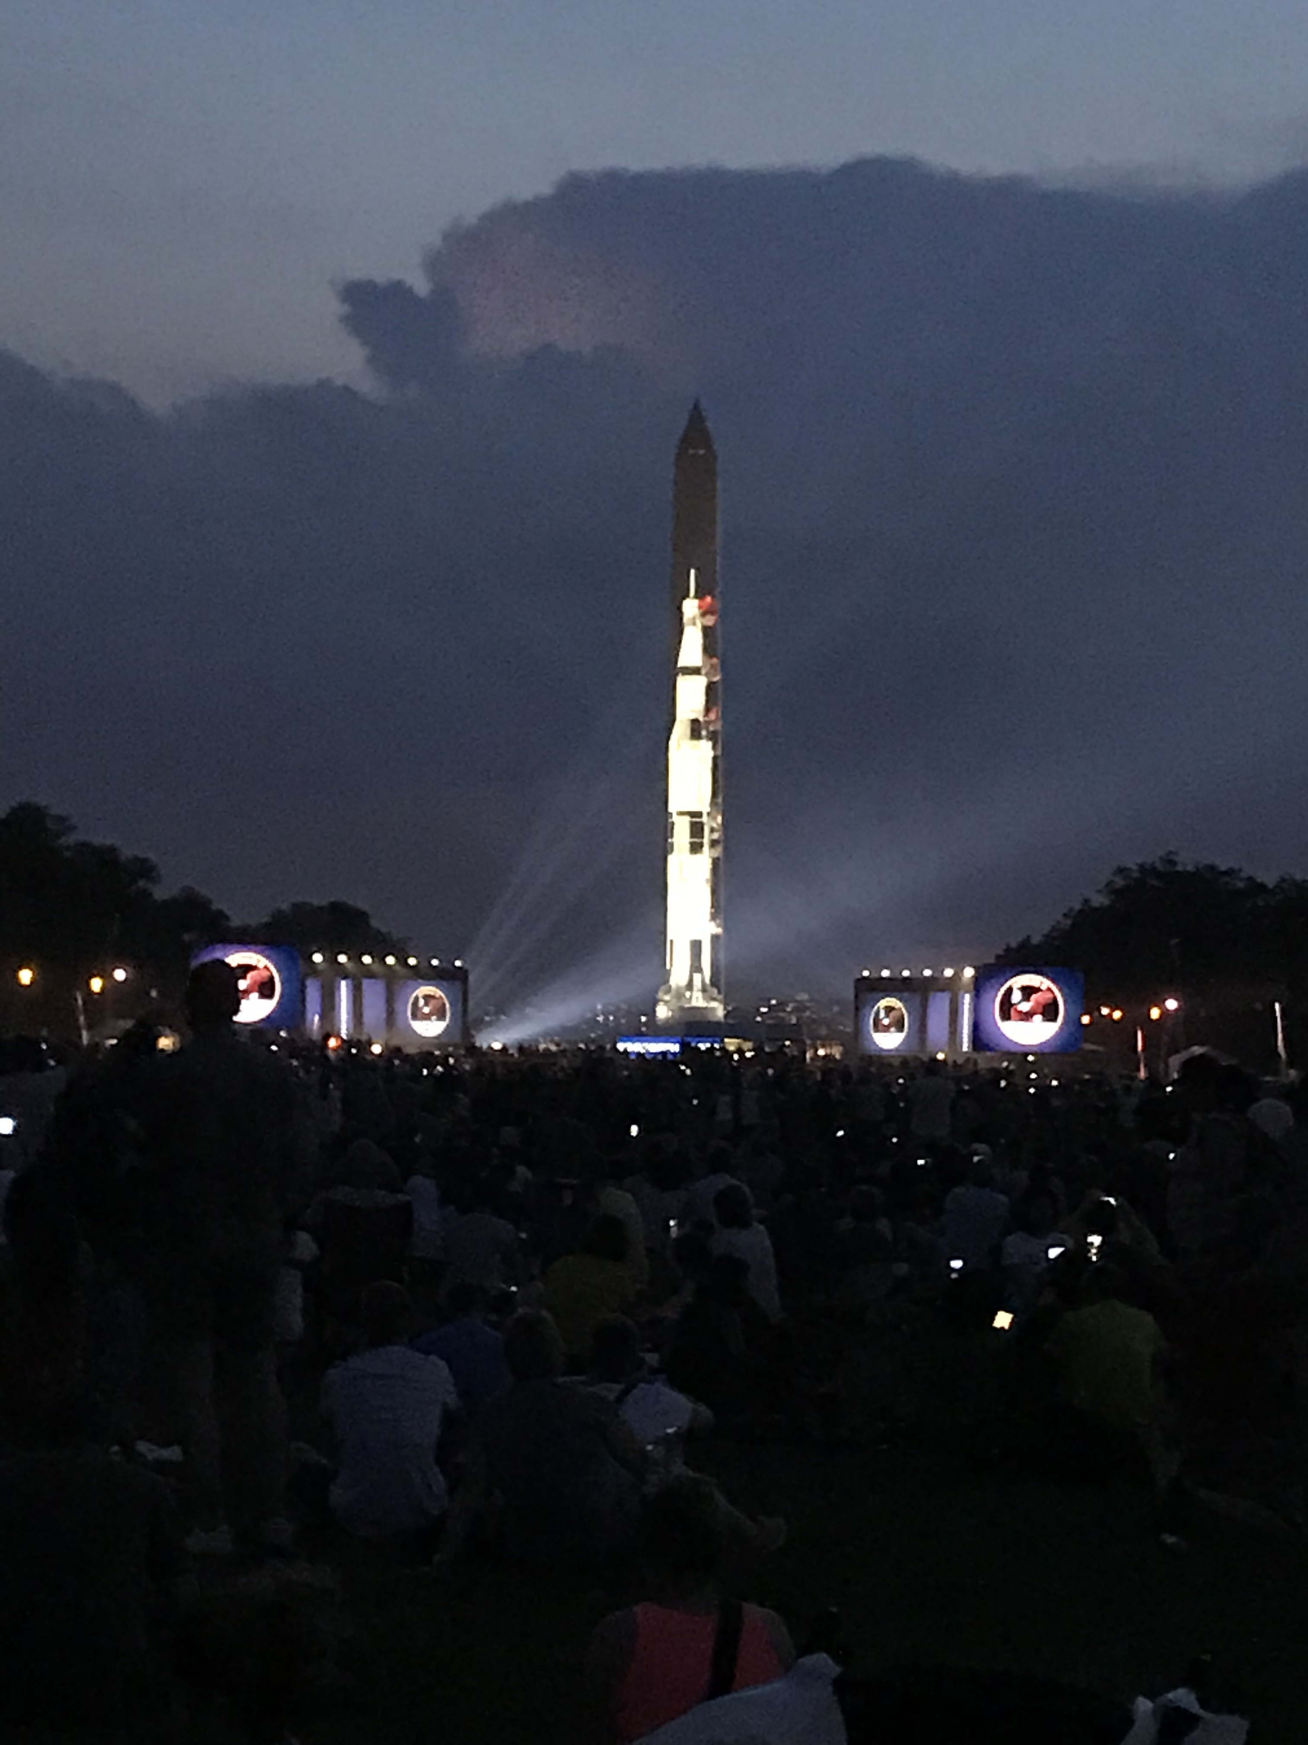
Why should we preserve?
Principle
  Posterity
  If you don’t, who will?
Pragmatism
  Marketing/PR
  Policy development
  Litigation support
  Recruiting
  Orientation and training
  Corporate, customer and product anniversary celebrations
Apollo 11 50th Anniversary – Wikimedia Commons

Slide 5
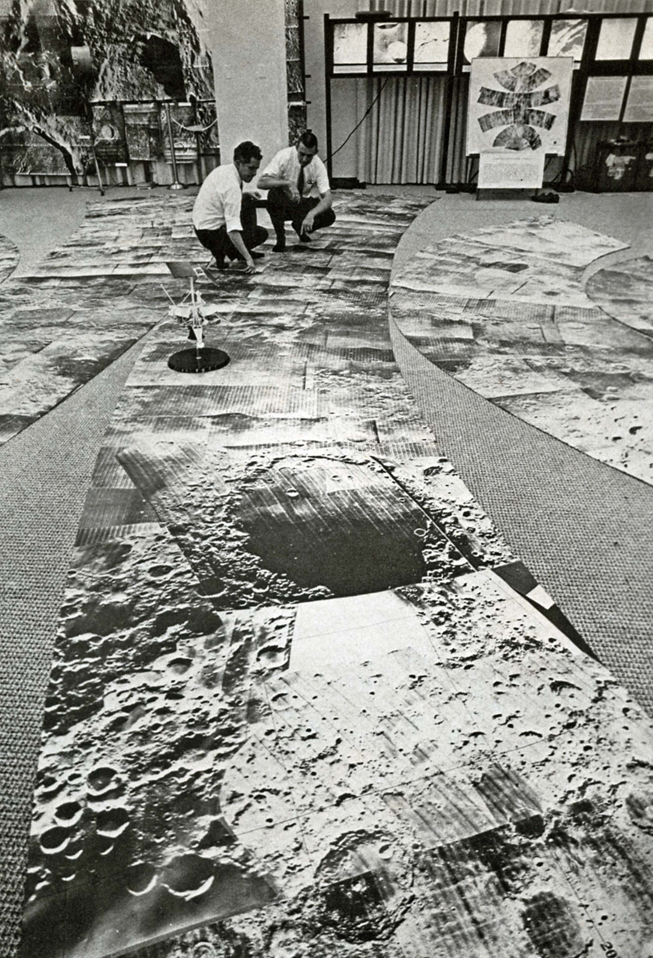
What should we preserve?
Documents, hardware, and recollections
Foundational documents
Drafts as well as final products
Paths taken and not taken
Artifacts – museums, not archives
Oral histories
Lunar Orbiter Photos – NASA

Slide 6
Common Concerns
Legal Liability
  Preserving documents enable you to present your story
Regulatory Compliance
  ITAR/Export Control
  Personal Identifying Information (PII)
Openness and Access
  Sensitive IP
  Business “Failures”
X-20 Dyna-Soar with pilots – Boeing Company Archives

Slide 7
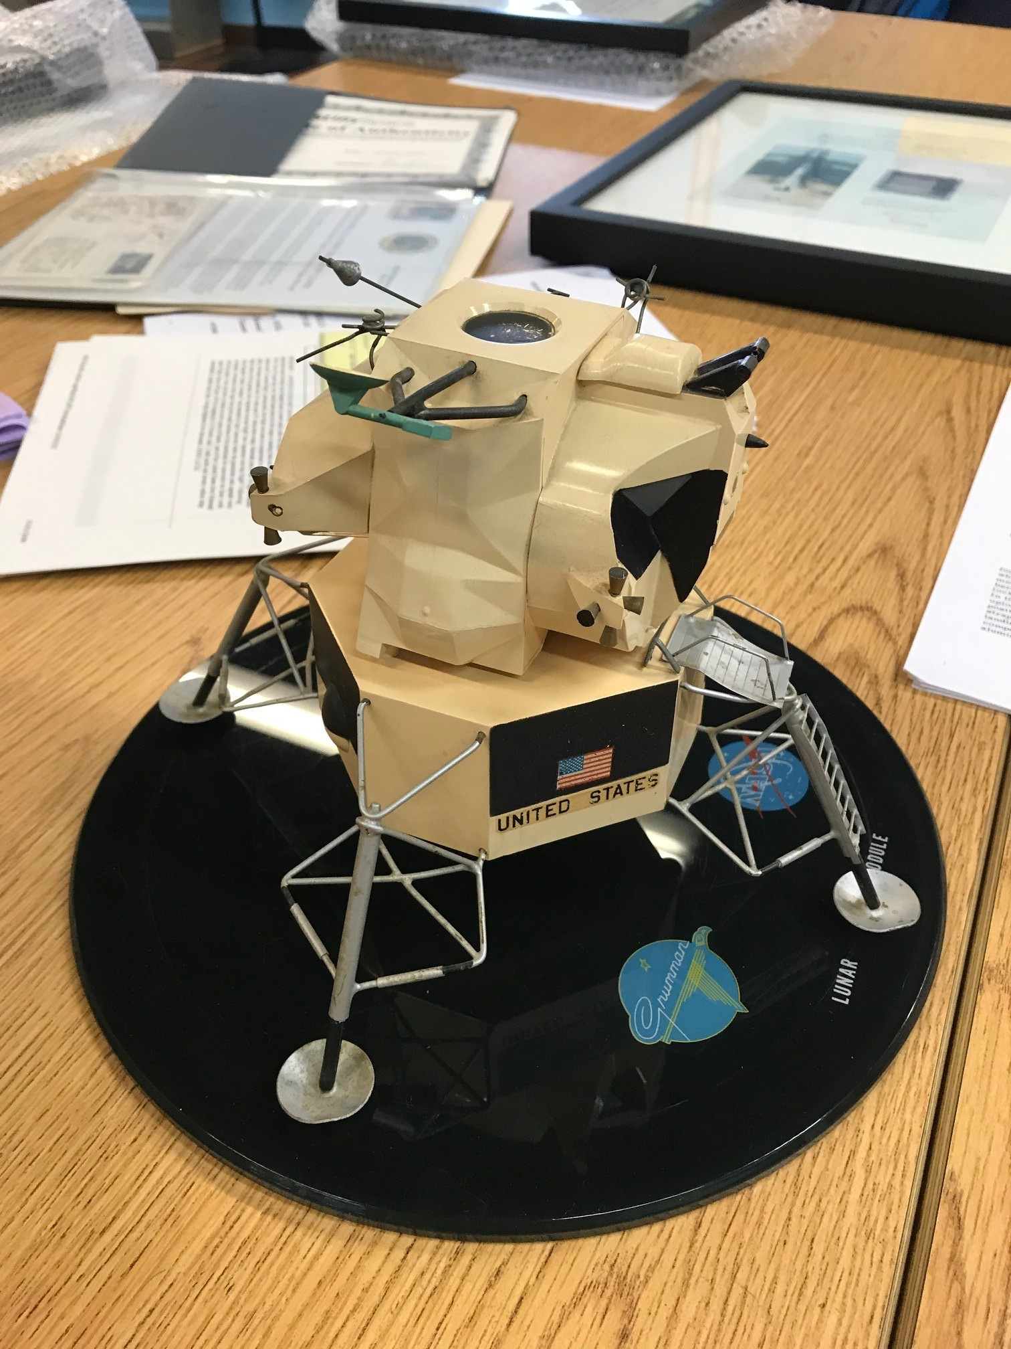
How do we preserve?
First, do no harm
Think through what you want to accomplish
Range of options
  DIY and personal archiving
  Consultants
  Friendly local space museum
  On-staff historian
Preserving ≠ Sharing
New Collection Intake Review – The Museum of Flight

Slide 8
Thank You!
ToBoldlyPreserve.space
Authors
Jonathan Coopersmith, j-coopersmith@tamu.edu
Angelina Callahan, angelina.callahan@nrl.navy.mil
Geoffrey Nunn, gnunn@museumofflight.org
Erik Rau, erau@hagley.org

Slide 9

www.ascend.events

Slide 10
To Boldly Preserve

